Slide 1
Student Name : Bareq Mohammed
Satellite Images Classification
Supervisor : Dr. Mohammed Al-Taie

Slide 2
What is the satellite image?
A satellite image is an image of the whole or part of the earth taken using artificial satellites. These images have a variety of uses, including: cartography, military intelligence and meteorology. Satellite images can either be visible light images, water vapor images or infrared images

Slide 3
What is the Satellite image classification?
Digital image classification techniques group pixels to represent land cover features. Land cover could be forested, urban, agricultural and other types of features.
There are three main image classification techniques.
- Unsupervised image classification - Supervised image classification - Object-based image analysis

Slide 4
Aim of Project
A satellite image goes through the process of classification, a land use classification map is one possible outcome. This map can be more successfully "read" and interpreted with its limited number of classes for uses such as planning.

Slide 5
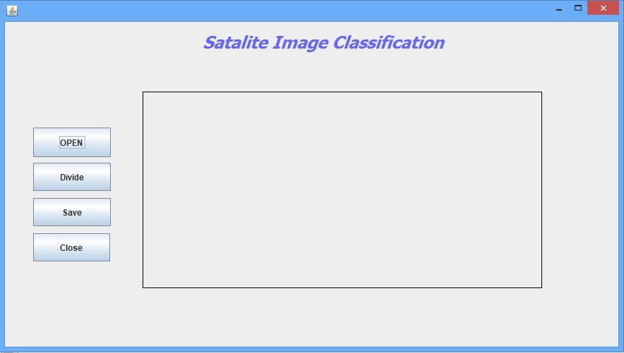
My Work :
Project Name
1.
Interface :
Loaded
Image
Load Image
Divide The Image
Save The New Image
Close The Program

Slide 6
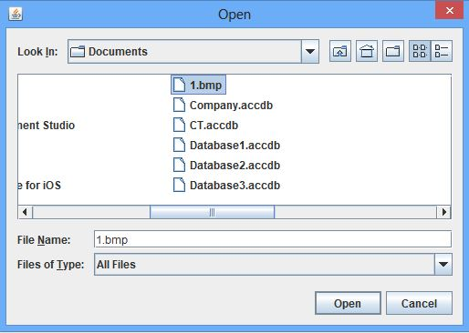
My Work :
2.
Open Button:
Selected Image

Slide 7
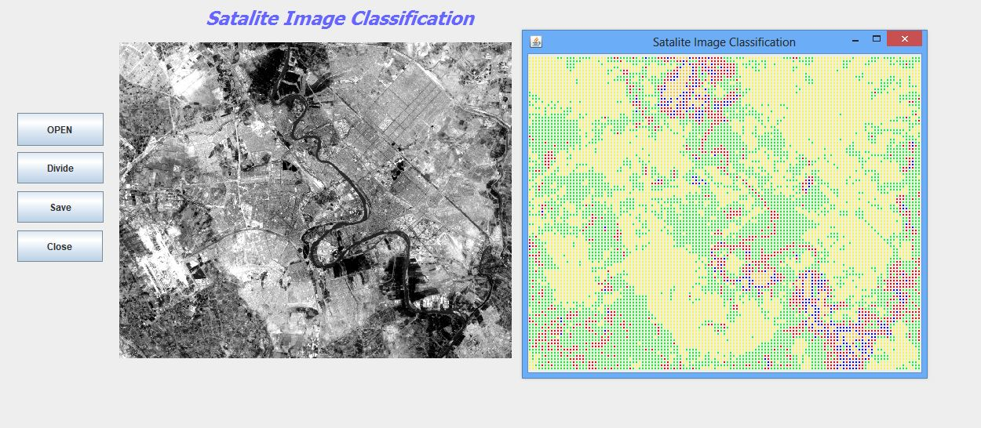
My Work :
New Image
My Image
3.
Divide Button:

Slide 8
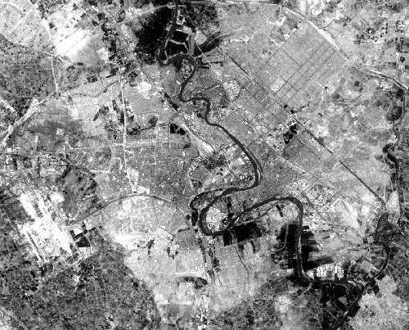
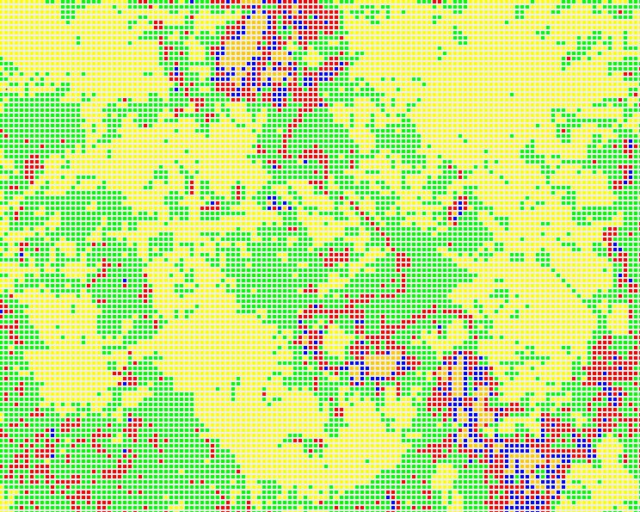



Result
Built-Up-Area
Gardens
Water
Soil

Slide 9
I’ve got the completion of work for more than 60%, according to the opinion of the supervisor

Slide 10
Thanks for Listening

